Slide 1
Connect4
By:
Artificial Masters
Team Members:
Manpreet Dhindsa, Taylor Nastally, Jake Anderson, Ashot Alajanyan

Slide 2
Agenda
Motivations
Introduction to Connect4
How to Play
How to Win
Introduction to our game/design
Overview of the various menus and app functionalities
How to Play our Python Application
Our Artificial Intelligence Designs
Random AI
Blocking AI
State Space Search AI
Alpha-Beta Pruning AI

Slide 3
Motivations
To get a better grounding and understanding of some fundamental AI approaches
In this case we wanted to better understand the AI algorithms used to play common two player games
This is important due to the relevance of AI when it comes to decision making and weighing optimal scenarios

Slide 4
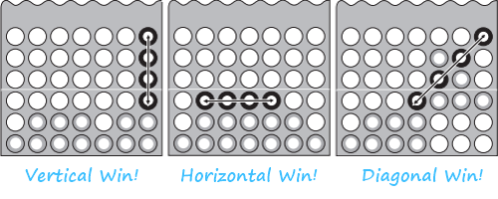
Connect4
2 Player Game
Both players alternate turns
Goal - Get 4 pieces in a row vertically, horizontally, or diagonally (+/- slope)
Gravity
Player only selects the column, piece will ‘fall’ to the next available row
Draw is possible if all 42 pieces are placed without a successful winner

Slide 5
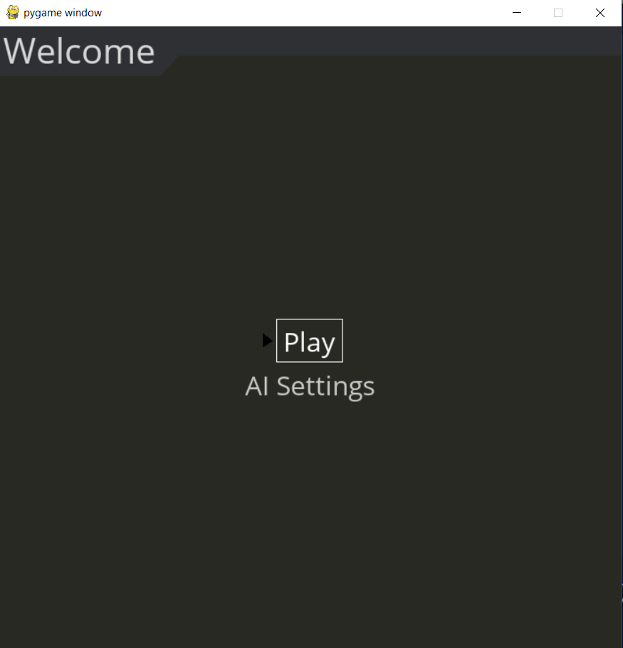
Python Implementation
Welcome Menu
Click on Play to begin game
Click on AI Settings to go to selection sub-menu (selectable AI options)

Slide 6
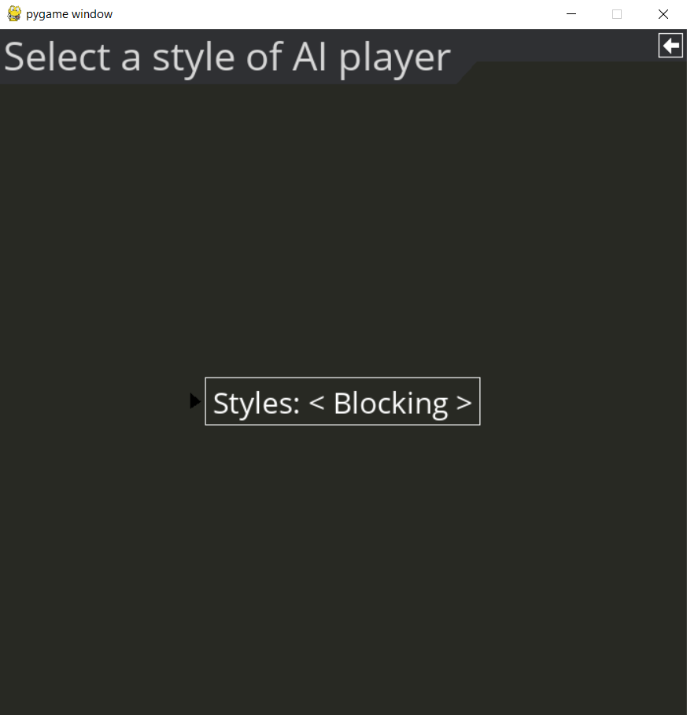



Python Implementation
AI settings sub-menu
Click between <> to change the AI modes
Random
Blocking
Alpha-Beta Pruning
State Space Search
Click on back arrow in top right corner to go back the Welcome Menu

Slide 7
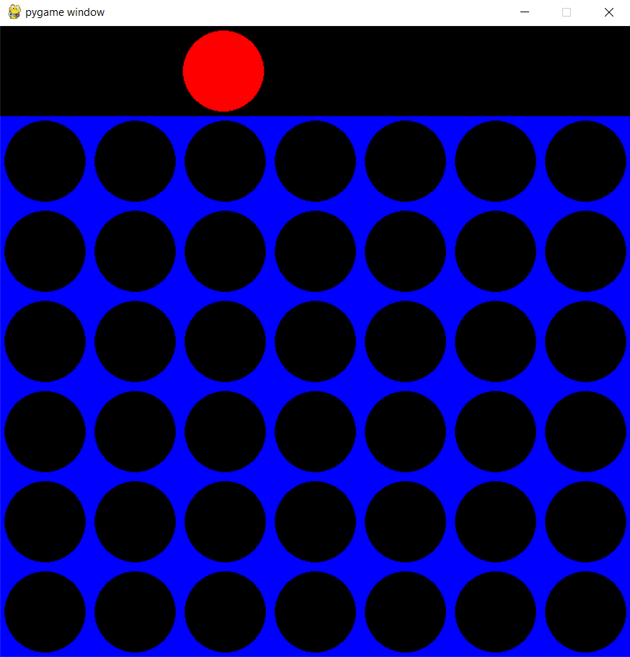
Python Implementation
Game Submenu
Click anywhere in the game window to place down a piece
Based on location of user click, a piece is placed in the next available row in the column that was selected (Gravity)
Player 1 = User
Player 2 = Artificial Intelligence

Slide 8
Random AI
This AI functions by randomly selecting a column, if the column is occupied, the AI will continue to select a new column until it picks an empty one
Time complexity: O(1)

Slide 9

Blocking AI
Recognizes a potential game winning move by the opponent
Seeks to block opponents game winning moves
Pseudo Code
Notes:
The blocking AI searches the board for potential game winning moves by the opponent. If a potential blocking move is found, the AI plays that move, else it will act as the random AI and play a random move.

Slide 10
Blocking AI
Brute Force Implementation
Time Complexity - O(m*n)
m is the number of rows
n is the number of columns
m is always 6 and n is always 7
Searches for Vertical, Horizontal, Negative Diagonal, and Positive Diagonal blocks
Also searches for ‘Gapped’ blocks in Horizontal, Negative Diagonal, and Positive Diagonal
Acts as Random AI if no block is found
There can be situations where there are more than 1 valid block, one is selected at random and played
Notes:
The Blocking AI is a brute force implementation. The time complexity is O (m*n) where m is the number of rows and n is the number of columns. In Connect 4, m and n are constants, 6 and 7 respectively. The AI searches for vertical, horizontal, negative diagonal, and positive diagonal blocks. It also searches for gapped blocks. Gapped blocks only apply to horizontal and diagonals. Please note there can be situations where there are more than 1 valid block, in this case, one block is selected at random and played.

Slide 11
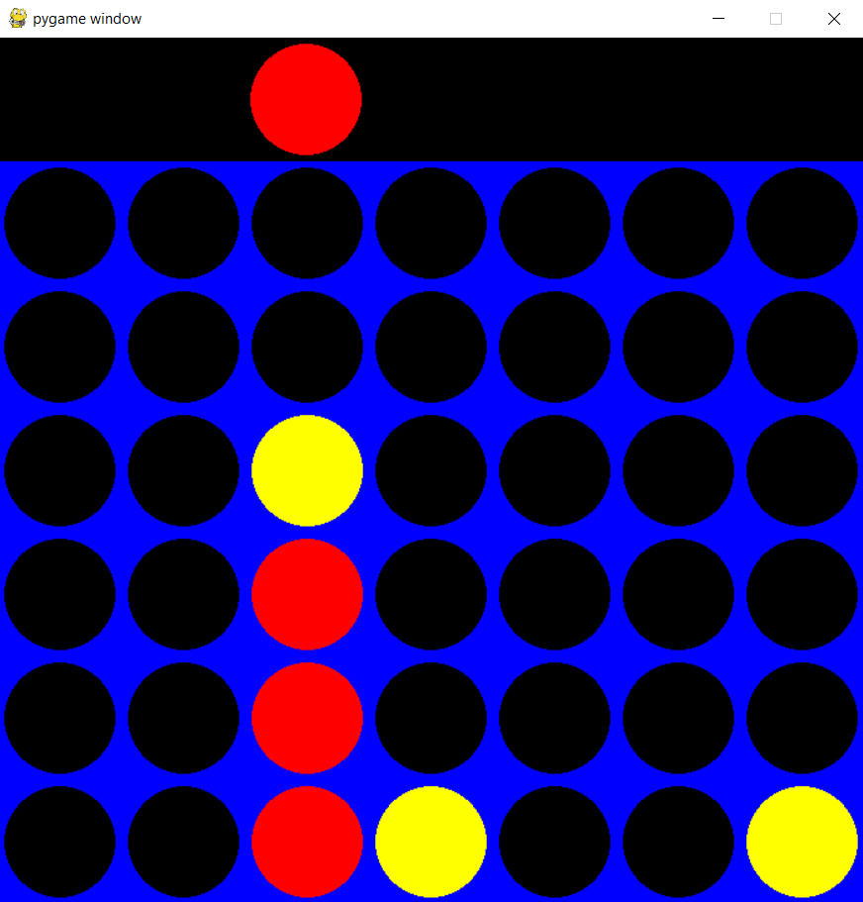
Blocking AI
Vertical Block
If user has 3 in a row vertically, the only possible block is row+3
AI plays yellow to board[3,2] to block user’s win
Notes:
If the user has 3 in a row vertically, the only possible block is row+3. The image shows a vertical block played by placing yellow to board[3,2].

Slide 12
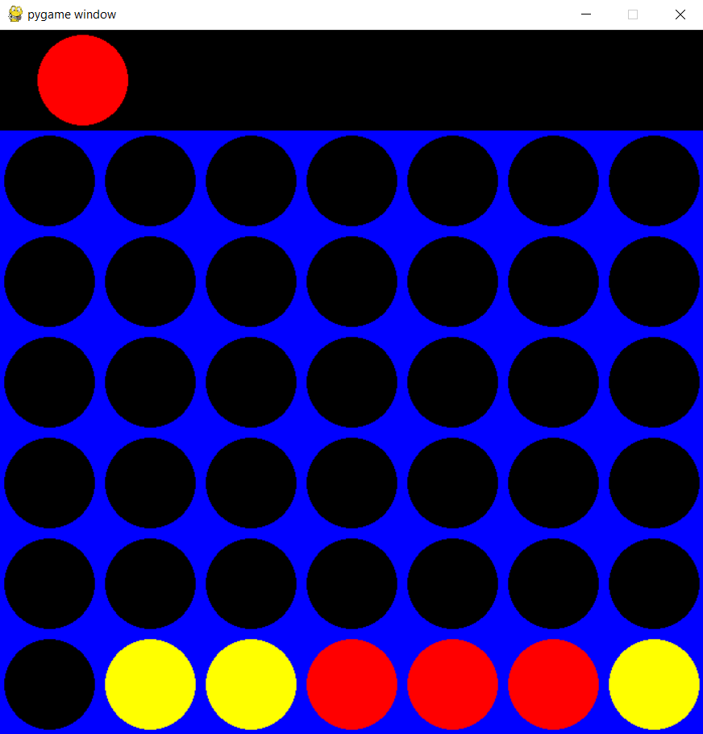
Blocking AI
Horizontal Block
If user has 3 in a row horizontally, possible blocks are column-1 or column+3
AI plays yellow to board[0,2] to block user’s win
Notes:
If the user has 3 in a row horizontally, the two possible blocks are column-1 or column+3. The image shows a horizontal block played by placing yellow to board[0,2].

Slide 13
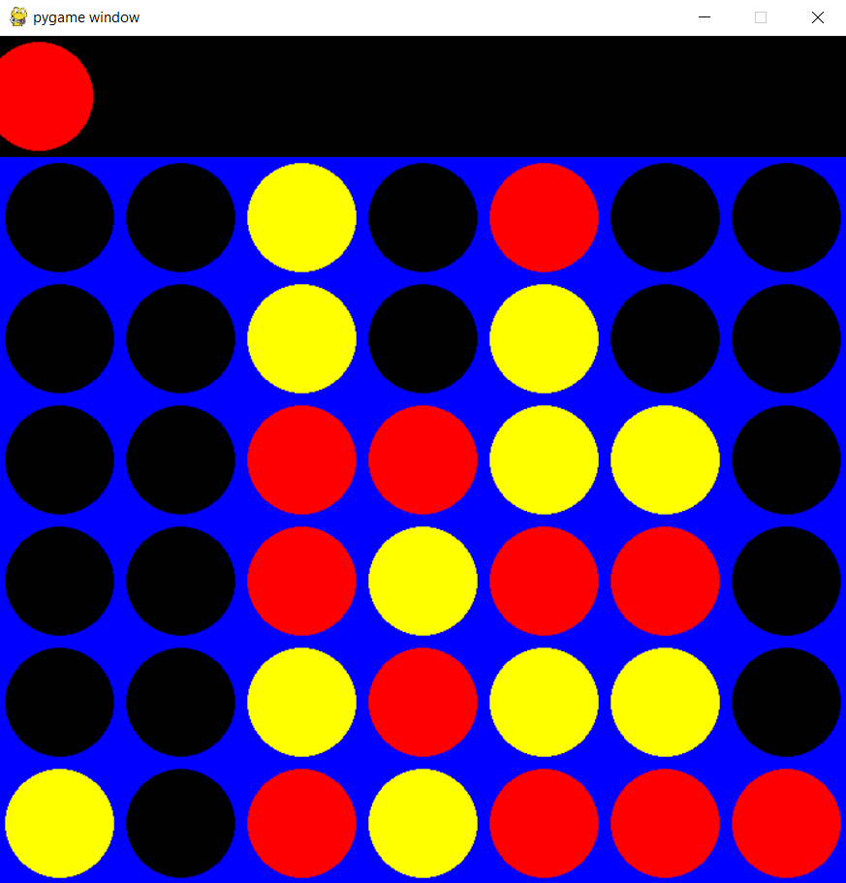
Blocking AI
Diagonal Block
If user has 3 in a row diagonally, possible blocks vary based on the slope
AI plays yellow to board[3,5] to block user’s win
Positive Slope Diagonal
Possible blocks are row-1, column-1 or row+3, column+3
Negative Slope Diagonal
Possible blocks are row+1, column-1 or row-3, column+3
Notes:
If the user has 3 in a row diagonally, the possible blocks vary based on the slope. For positive diagonal slopes, the possible blocks are row-1,column-1 or row+3,column+3. For negative diagonal slopes, the possible blocks are row+1,column-1 or row-3,column+3.The image shows a diagonal block played by placing yellow to board[3,5].

Slide 14
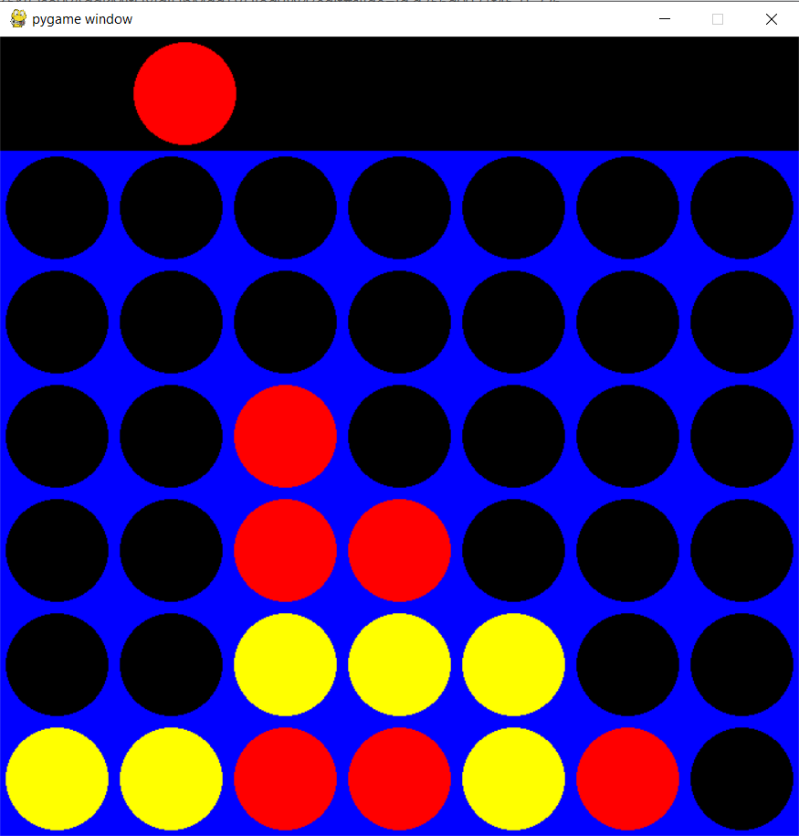
Blocking AI
Gapped Blocks
Only applies to horizontal or diagonal blocks
Previous searches blocked as follows OOOX or XOOO
Gapped blocks are the following OXOO or OOXO
AI plays yellow to board[1,4] to block user’s win
Notes:
Now lets take a look at gapped blocks. Gapped blocks only apply to horizontal or diagonal blocks. Previously, we looked at blocks that recognized 3 in a row and blocked by not allowing the edge piece to be placed. A gapped block seeks to block a game winning move where the blocking coordinate is in the middle of the 4 in a row, rather than the edge. In the image, you can see player has a potential game winning negative slope, the AI recognizes a gapped block and plays board[1.4]

Slide 15
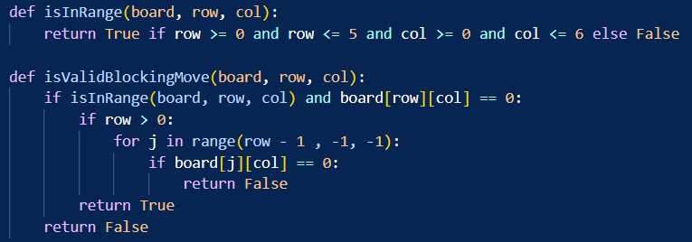
Blocking AI
If many possible blocking coordinates are found
AI selects a coordinate that is in range and valid
In range verifies that the coordinate is on the board
Valid verifies if all rows below that coordinate are occupied
Handles the ‘Gravity’ aspect of Connect4
Notes:
Just to reiterate, If many blocking coordinates are found, the AI selects a coordinate that is in range and valid. By valid I am referring verifying the gravity aspect of Connect4 (verifying every row below is populated). And you can also see a snippet of the valid checks.

Slide 16
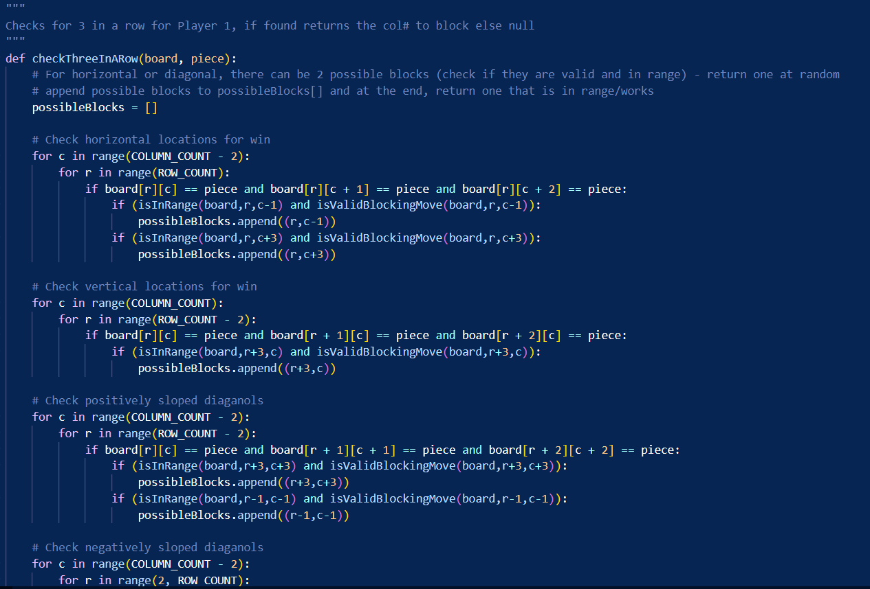
Blocking AI - Python Implementation
Notes:
And here you can see a snippet of the blocking AI code.

Slide 17

Alpha-Beta Pruning AI
An adversarial search algorithm (one which traces opponents moves)
Best case time complexity of in which b is the branching factor and d is the depth of the game tree
Utilizes the minimax algorithm, proceeding in a depth-first search, maintaining two values of alpha and beta
Alpha represents the minimum score that the maximizing player is assured of, while the beta represents the maximum score the minimizing player is assured of

Slide 18
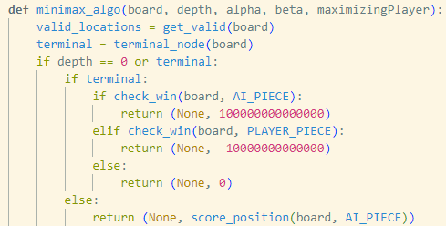
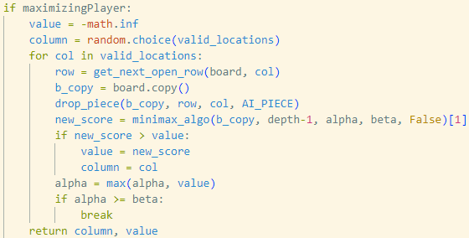
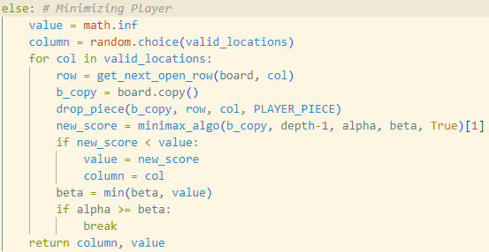
The Minimax Algorithm
Maximizing Player Minimizing Player

Slide 19
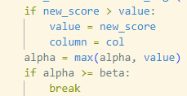
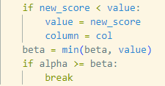
Alpha-Beta Pruning in Minimax
Obtaining Alpha values Obtaining Beta values
In these instances, the minimax algorithm will weigh each new value (score) against the tree’s previous value (greater for maximizing player, lesser for minimizing player), and will update the alpha/beta values if the appropriate conditions have been met.

Slide 20
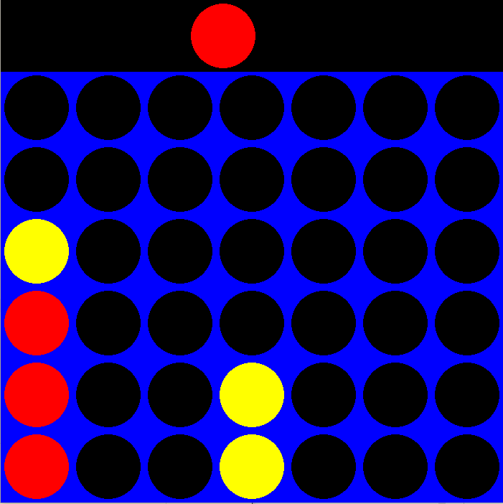
Alpha-Beta Pruning AI
A simple example of the Alpha-Beta pruning AI making the best move. Although placing a third yellow in a row can still be considered a good move, that would lead to a loss next move, so the AI chooses to block the user.

Slide 21
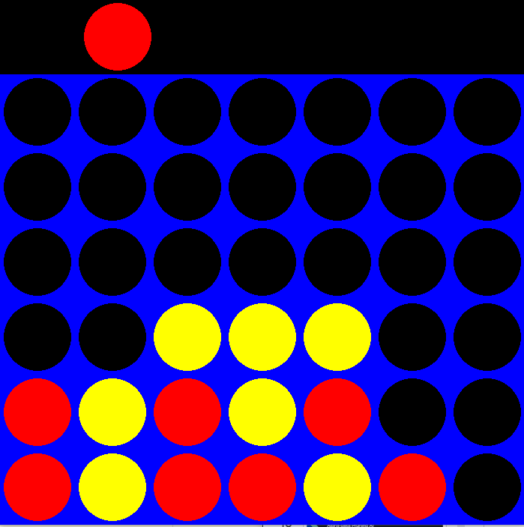
Alpha-Beta Pruning AI
Here the AI has led itself to a best case scenario. If the player drops red the Alpha-Beta pruning will win. However if the player chooses to avoid it the path to the win has still been found.

Slide 22
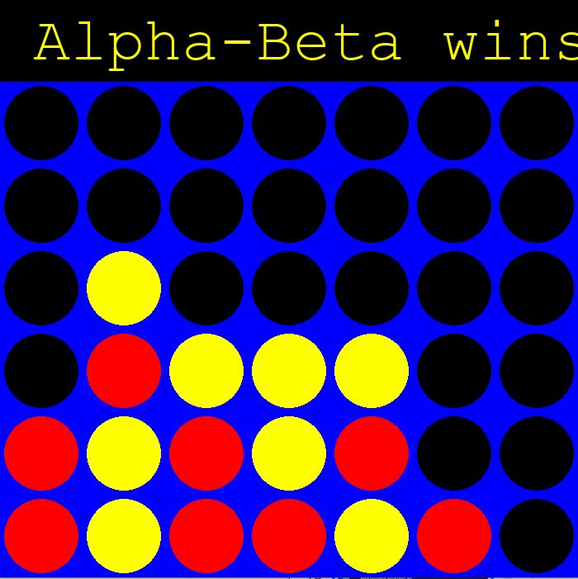
Alpha-Beta Pruning AI
The next move by the player was made, however the Alpha-Beta Pruning AI sees the win and chooses the best case.

Slide 23
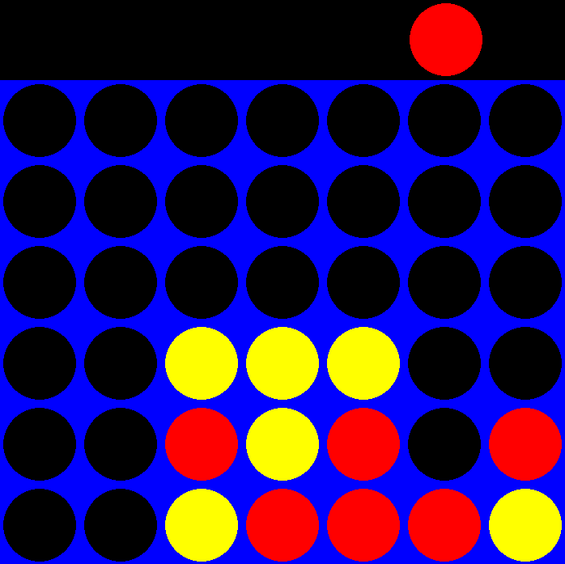
Alpha-Beta Pruning AI
This AI is not foolproof however and is prone to making less than optimal moves. In this example if the player drops a red down the AI can win in the next turn.

Slide 24
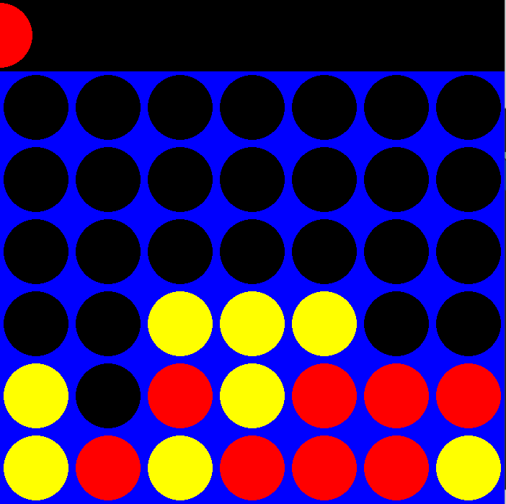
Alpha-Beta Pruning AI
However here we see that the player has made the move opening up the Alpha-Beta Pruning AI win but the AI chooses a different, less optimal move.

Slide 25
State Space Search AI
This AI functions by creating board states, playing pieces randomly, then scoring those plays
The best board states are returned from with a higher score and are then played
Due to the intensity and breadth of the search, the depth has been limited to 3 plays in
This has the side-effect of being an easier AI to play against than A-B Pruning because it cannot easily see winning moves

Slide 26
State Space Search AI
State Space Search plays the most optimally out of the group
Connect 4 has over 4.5 trillion possible combinations of pieces
Even with 3-ply lookahead restrictions, it is incredibly intense and there is a noticeable delay while the AI builds a tree to make the best move
From playing the game, it is evident that this AI is the most difficult to play against

Slide 27
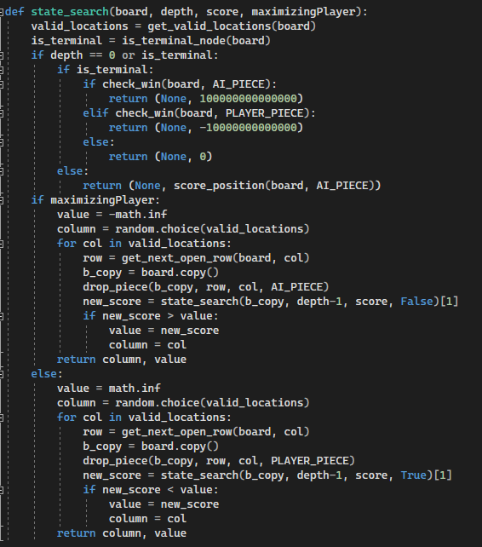
State Space Search AI
This search calculates the heuristic value of prospective moves on a copied board
Once the moves are simulated, they are scored and whichever move has the highest heuristic score is played
This function is nearly identical to A-B Pruning but disregards the logic of avoiding unproductive searches. Therefore, this AI takes slightly longer to make moves.

Slide 28
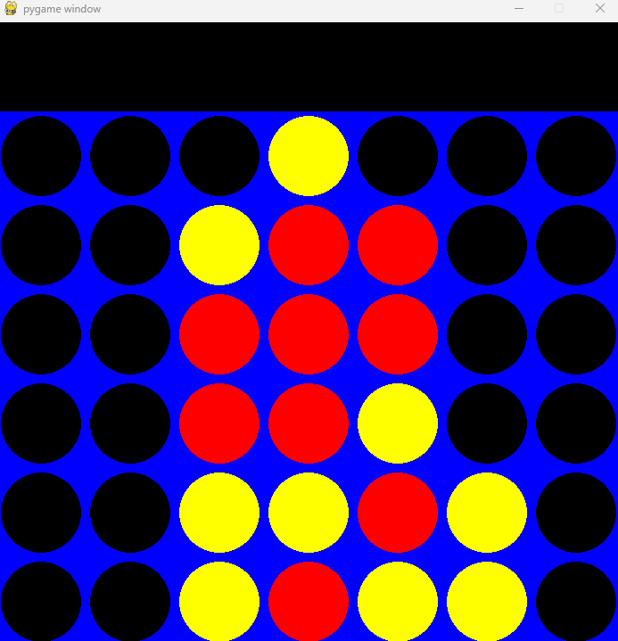
State Space Search AI
This AI makes the best move in all possible circumstances.
It covers blocking, searching for a win, and focusing on the center.
It can also identify useless threats
State space search will never make an entirely random move.

